Slide 1
FIT1045 Introduction to Algorithms and Programming Lecture 8 Greedy Approach
COMMONWEALTH OF AUSTRALIA
Copyright Regulations 1969
WARNING
This material has been reproduced and communicated to you by or on behalf of Monash University pursuant to Part VB of the Copyright Act 1968 (the Act).The material in this communication may be subject to copyright under the Act.Any further reproduction or communication of this material by you may be the subject of copyright protection under the Act.
Do not remove this notice.

Slide 2
Greedy Algorithm
At each step make a locally optimal choice (with respect to some property).
Sometimes solution is not optimum.
For some problems, the greedy algorithm always finds an optimum solution.

Slide 3
Overview
Selection Sort
Change Problem
Electrical Problem
Torch
Knapsack

Slide 4
Selection Sort
Algorithm SelectionSort(L)
// Sorts a list using selection sort
// Input: A list of orderable items
// Output: A list sorted in increasing order
n ⟵ length(L)
k ⟵ 0
while k < n {
Find the minimum item in L[k:n-1]
Put the item in the correct position
k ⟵ k + 1
}

Slide 5
Selection Sort
Algorithm SelectionSort(L)
// Sorts a list using selection sort
// Input: A list of orderable items
// Output: A list sorted in increasing order
n ⟵ length(L)
k ⟵ 0
while k < n {
Find the minimum item in L[k:n-1]
Put the item in the correct position
k ⟵ k + 1
}

Slide 6
Selection Sort: Code
‘Sort a list using Selection Sort’
n = len(aList)
for k in range(n-1):
‘Find the position of the minimum value aList[k:]’
min_position = k
for j in range(k+1, n):
if aList[j] < aList[min_position]:
min_position = j
‘Swap values in postions k and min_position’
aList[k], aList[min_position] = aList[min_position], aList[k]

Slide 7
What does the list [5, 3, 1, 2, 4] contain after the first iteration of the loop in Selection sort?
[5, 3, 1, 2, 4]
[3, 5, 1, 2, 4]
[1, 3, 5, 2, 4]
[1, 3, 1, 2, 4]

Slide 8
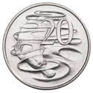

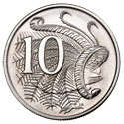
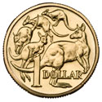
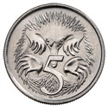
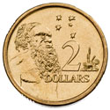
Change Problem
Suppose you are required to give change using coins with the denominations 5c, 10c, 20c, 50c, $1, and $2.
Describe an algorithm which gives the change for any amount, which is a multiple of 5c, in the fewest number of coins.
http://www.ramint.gov.au/designs/ram-designs
Notes:
Ask whether this algorithm would work for other denominations.

Slide 9
Using 5c, 10c, and 20c, what is the number of ways you can give change of 35c?
3
4
5
None of the above

Slide 10
Electrical Problem
Suppose an electrical engineer, has terminals that need to be connected with wires. Describe an algorithm so that the least amount of wire is used.
Notes:
Talk about minimum spanning trees.

Slide 11
Possible Solution
Wire
Notes:
Talk about minimum spanning trees.

Slide 12
Possible Solution
Spanning Tree with the minimum total length.
Notes:
Talk about minimum spanning trees.

Slide 13
Problem
Consider the graph consisting of the following:
Vertices corresponding to the terminals
Edges joining each pair of vertices
Weight on each edge corresponding to the length of the edge.
Find a spanning tree of this graph with minimum total weight.

Slide 14
Prim’s algorithm for finding a spanning tree
Choose a vertex in the Graph
Add the edge to the Tree.
Put the vertex in the Tree
Is there a vertex not in the Tree?
Yes
Choose an edge between a vertex in the Tree and a vertex not in tree
No
Output Tree
Notes:
Illustrate how this algorithm works.

Slide 15
Prim’s algorithm for finding a minimum spanning tree.
Choose a vertex in the Graph
Add the edge to the Tree.
Put the vertex in the Tree
Is there a vertex not in the Tree?
Yes
Choose an edge with the minimum weight between the Tree and a vertex not in tree
No
Output Tree
Notes:
Illustrate how this algorithm works.

Slide 16
What is the total weight of the minimum spanning tree for the following graph?
1
4
6
3
4
5
5
2
14
15
16
None of the above
6
8

Slide 17
1
6
3
4
4
5
5
2
6
8

Slide 18
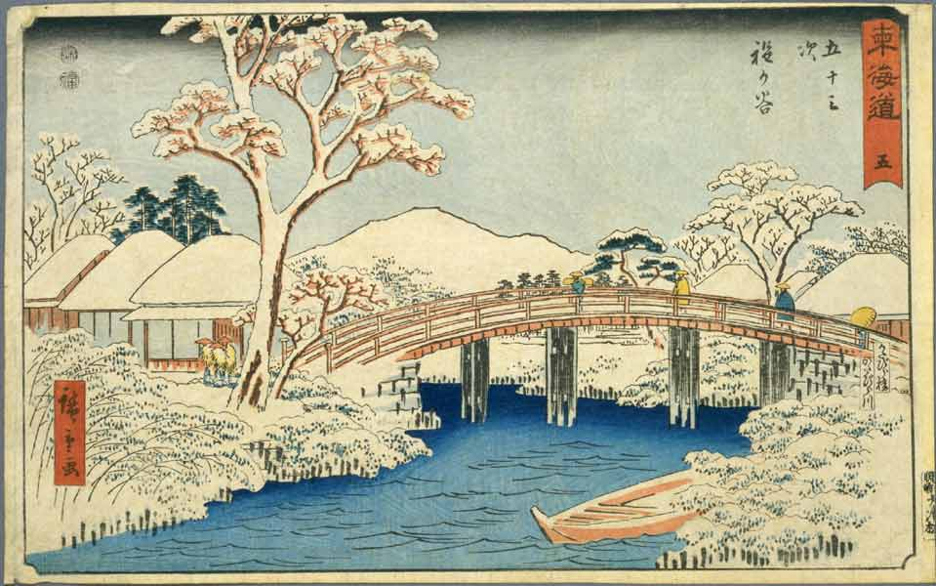
A Torch Problem
Ando Hiroshige (http:www.hiroshige.org.uk)
Four people wish to cross a bridge at night. They need a torch to cross and they only have one torch between them. Also, since the bridge is narrow, they can only cross at most two at a time, and can only travel at the speed of the slowest. The four people can cross in 1 minute, 2 minutes, 5 minutes and 10 minutes, respectively.
Find a way for them to cross in the minimum about of time.
Notes:
18
Describe a greedy algorithm for this problem.

Slide 19
The four people can cross in 1 minute, 2 minutes, 5 minutes and 10 minutes, respectively. What is the minimum time to get the four people across the bridge in the torch problem?
15
17
19
None of the above
Ando Hiroshige (http:www.hiroshige.org.uk)

Slide 20
Greedy Approach
Fastest takes the flashlight !

Slide 21

Knapsack Problem
http://www.unusualbag.com/

Slide 22
Knapsack
Suppose you are in a treasure cave which contains 6 precious items, with the following weights and monetary value.
You want to take as much treasure as you can carry.
However, you can only carry up to 20kg.
Which items do you take?
Item | 1 | 2 | 3 | 4 | 5 | 6
Weight | 20kg | 10kg | 9kg | 4kg | 2kg | 1kg
Value | $4000 | $3500 | $1800 | $400 | $1000 | $200

Slide 23
Greedy Approaches
At each stage take the most valuable item that can fit.
At each stage take the lightest element that can fit.
At each stage take the item with the highest value per unit weight that can fit.

Slide 24
Greedy Approaches
Take the most valuable!
Take the lightest!
Take the item with most value per weight!

Slide 25
What have you learnt?
Greedy approach sometimes gives the optimal solution.
Greedy approaches come in different variations.
Greedy approach does not always give the optimum solution.
Greedy approach is a good starting point.

Slide 26
Before Next Lecture
Read Chapter 3 in “Introduction to The Design and Analysis of Algorithms”.
Log onto the FIT1045 Moodle site:
Watch the following videos:
Brute Force
The Boat Problem
Attempt the following problems …

Slide 27
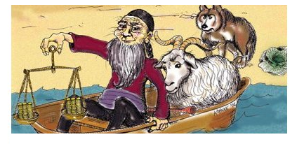
A Boat Problem
A farmer wishes to take a goat, a cabbage and a wolf across a river. However, his boat can only take one of them at a time. Therefore he will need to make several trips. Also, he cannot leave the goat alone with the cabbage, and cannot leave the wolf alone with the goat.
Find a way for the farmer to get everything across the river.
Cover Design of Anany Levitin, Introduction to the Design and Analysis of Algorithms (2nd Edition)

Slide 28
8 Queens
Q
Consider a standard chessboard. Can you place 8 queens on the board so that none of them are attacking each other?

